Slide 1

HiEff ModTM Combined Cycle
Power Generation System
General Atomics
September 27, 2016
Donald R. Wilson
Professor and Associate Chair
Department of Mechanical and Aerospace Engineering
University of Texas at Arlington
Arlington, TX 76017

Slide 2

HiEff ModTM Combined Cycle
Power Generation System
Outline
  Introduction - Simpkin HiEff ModTM Hi Efficiency Utility Rescue Concept
  NPSS Simulation Model
  HiEff/Rankine Combined Cycle
    Cycle Design & Performance Analysis
    Helium Compressor Model
    Indirect Helium/Argon Cycle
    Experimental Validation
  HiEff/sCO₂ Combined Cycle
    Cycle Design & Performance Analysis
    Experimental Validation
  HiEff/SC-FGR Cycle
  Path to Commercialization
  Appendix - NPSS Code

Slide 3


Slide 4
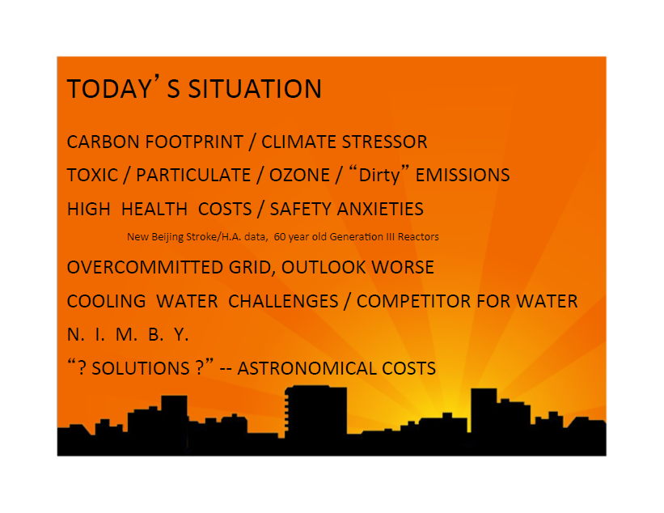

Slide 5
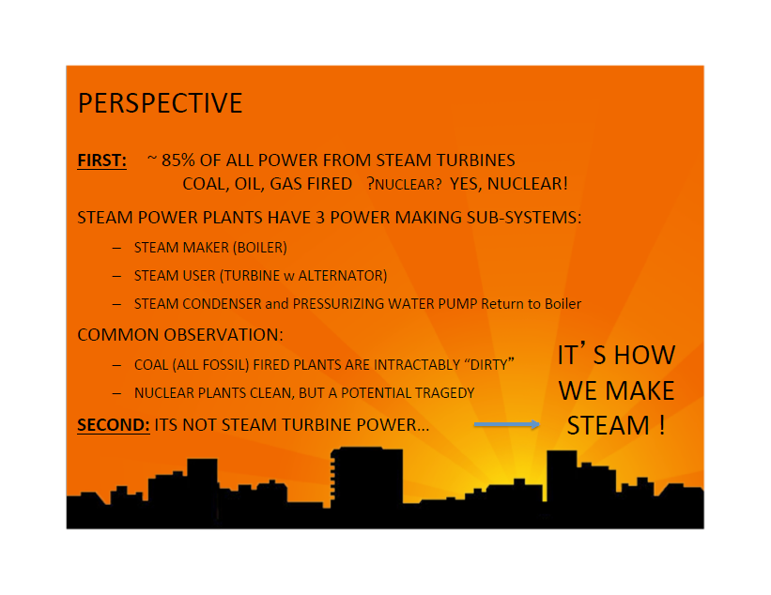

Slide 6
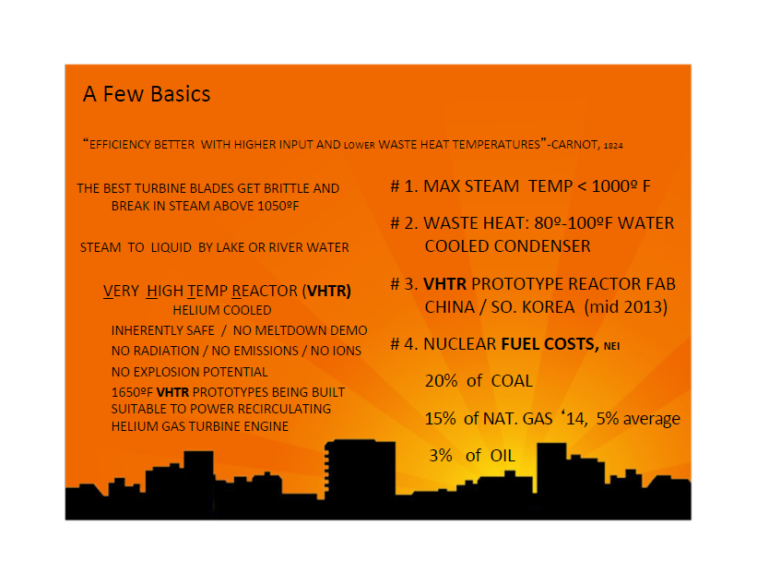

Slide 7
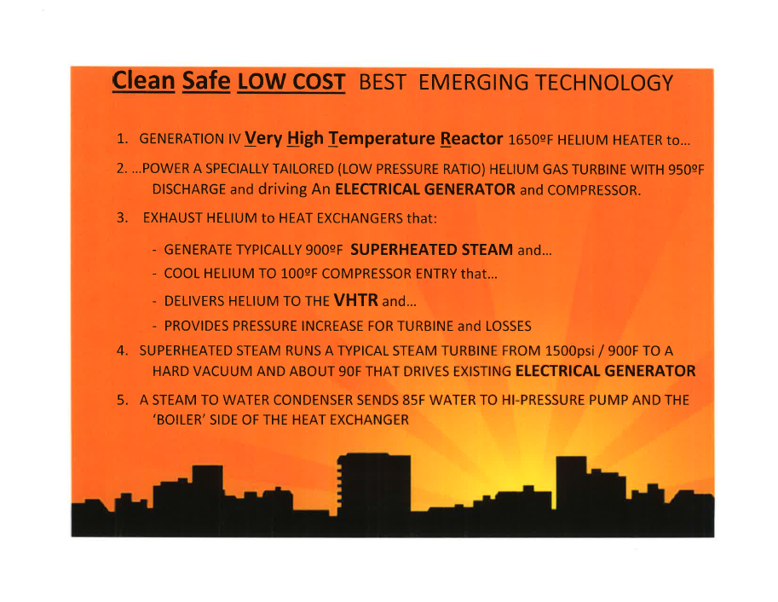

Slide 8
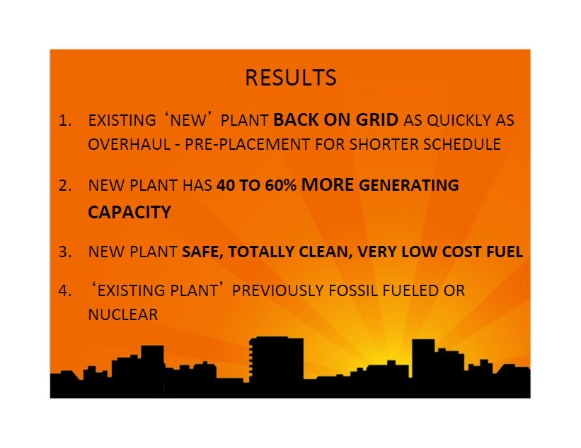

Slide 9
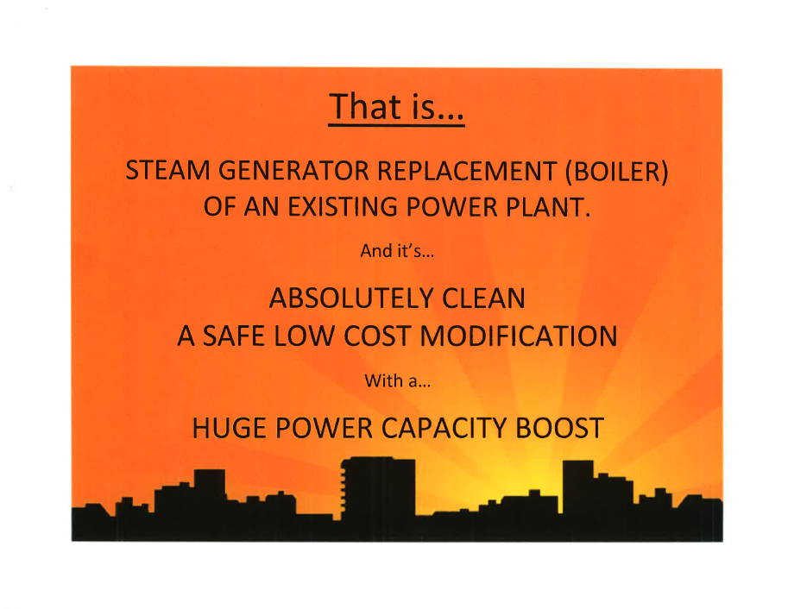

Slide 10


Slide 11
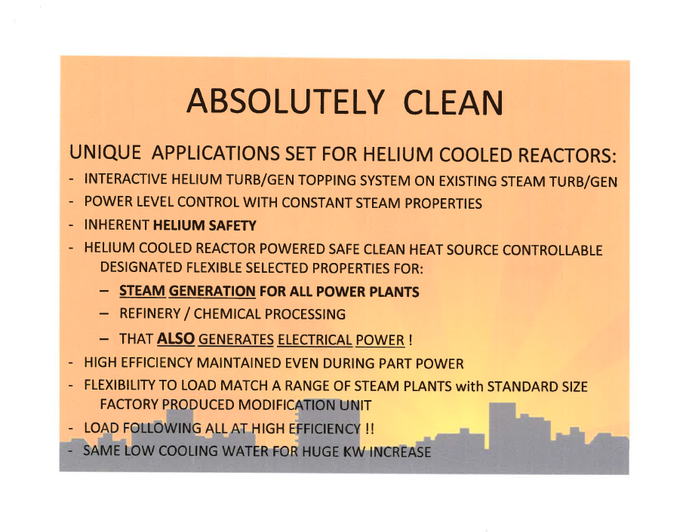

Slide 12
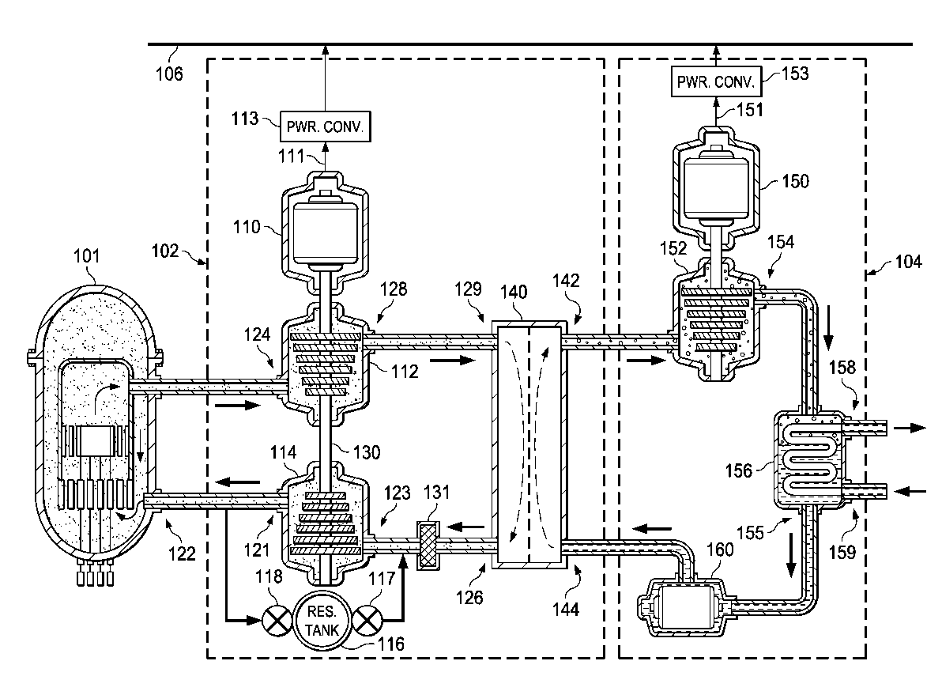
High efficiency power generation system and system upgrades
US 8826639 B2
ABSTRACT
A thermal/electrical power converter includes a gas turbine with an input couplable to an output of an inert gas thermal power source, a compressor including an output couplable to an input of the inert gas thermal power source, and a generator coupled to the gas turbine. The thermal/electrical power converter also includes a heat exchanger with an input coupled to an output of the gas turbine and an output coupled to an input of the compressor. The heat exchanger includes a series-coupled super-heater heat exchanger, a boiler heat exchanger and a water preheater heat exchanger. The thermal/electrical power converter also includes a reservoir tank and reservoir tank control valves configured to regulate a power output of the thermal/electrical power converter.
Publication number | US8826639 B2
Publication type | Grant
Application number | US 13/971,273
Publication date | Sep 9, 2014
Filing date | Aug 20, 2013
Priority date | Aug 22, 2012
Also published as | CN104662262A, 7 More »
Inventors | William Edward Simpkin
Original Assignee | Hi Eff Rescue LLC
Currently applying for patents in China and European Union

Slide 13
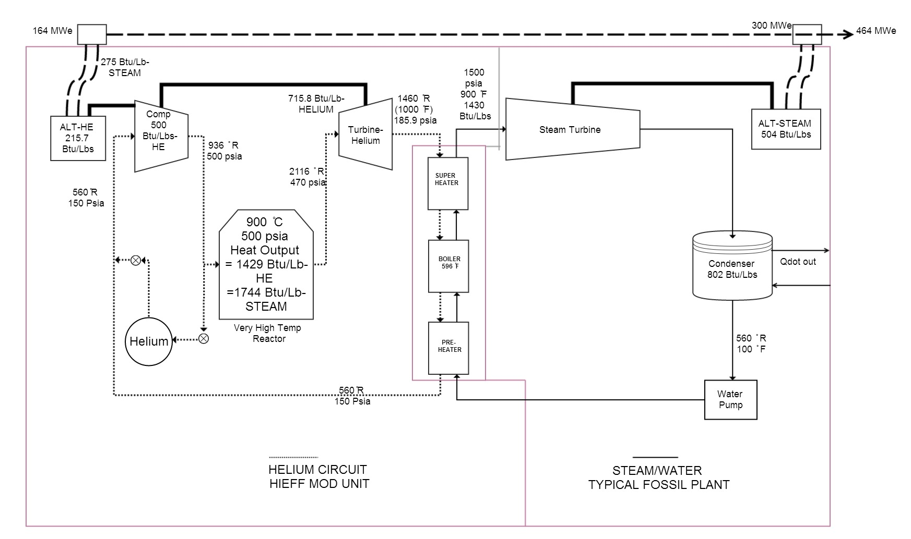
HiEff ModTM Power Generation System
(Cycle Schematic ~ W. E. Simpkin)

Slide 14
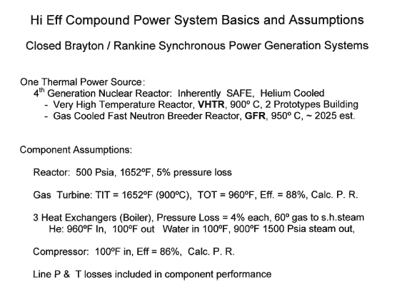
HiEff ModTM Power Generation System
(Preliminary Performance Estimate)
Preliminary Results
1100 MW_{TH} Heat input
Electrical power output:
300 MW (Steam turbine)
164 MW (Gas turbine)
Plant efficiency: 42 %

Slide 15
HiEff ModTM Combined Cycle
Power Generation System
Outline
  Introduction - Simpkin HiEff ModTM Hi Efficiency Utility Rescue Concept
  NPSS Simulation Model
  HiEff/Rankine Combined Cycle
    Cycle Design & Performance Analysis
    Helium Compressor Model
    Indirect Helium/Argon Cycle
    Experimental Validation
  HiEff/sCO₂ Combined Cycle
    Cycle Design & Performance Analysis
    Experimental Validation
  HiEff/SC-FGR Cycle
  Path to Commercialization
  Appendix - NPSS Code

Slide 16
  NPSS Simulation Model
(Introduction)
NPSS - Numerical Propulsion System Simulation
NPSS is an object-oriented computer code written in C++, originally developed for simulation of gas turbine engines, but capable of simulating any thermal cycle
Developed by consortium of NASA GRC, Air Force AFRL and AEDC, and major aerospace engine and airframe companies
Robust solver - provides flexibility in performing cycle design and off-design performance analysis of complex systems
The NPSS architecture allows the complexity of individual component elements to range from simple 0-D models to full 3-D CFD models
Allows the simulation of engine transients as well as steady state operation.

Slide 17
  NPSS Simulation Model
(NPSS Legacy)
Cycle analysis
Air Force SMOTE (Simulation of Turbofan Engine, AFAPL-TR-67-125, 1967)
NASA GENENG (NASA TND-6552, 1972) and GENENG -II (NASA TND-6553, 1972)
Navy NEPCOMP (Navy Engine Performance Code, ASME Paper 74-GT-83, 1974)
NNEP (Navy/NASA Engine Code, NASA TMX-71857, 1975)
NEPP (NASA Engine Performance Code, NASA TM 106575, 1994)
Transient simulation
Analog simulation (NASA TND-6610, 1972)
"HYDES (NASA TMX-3014, 1974)
DYNGEN (NASA TND-7901, 1975)

Slide 18
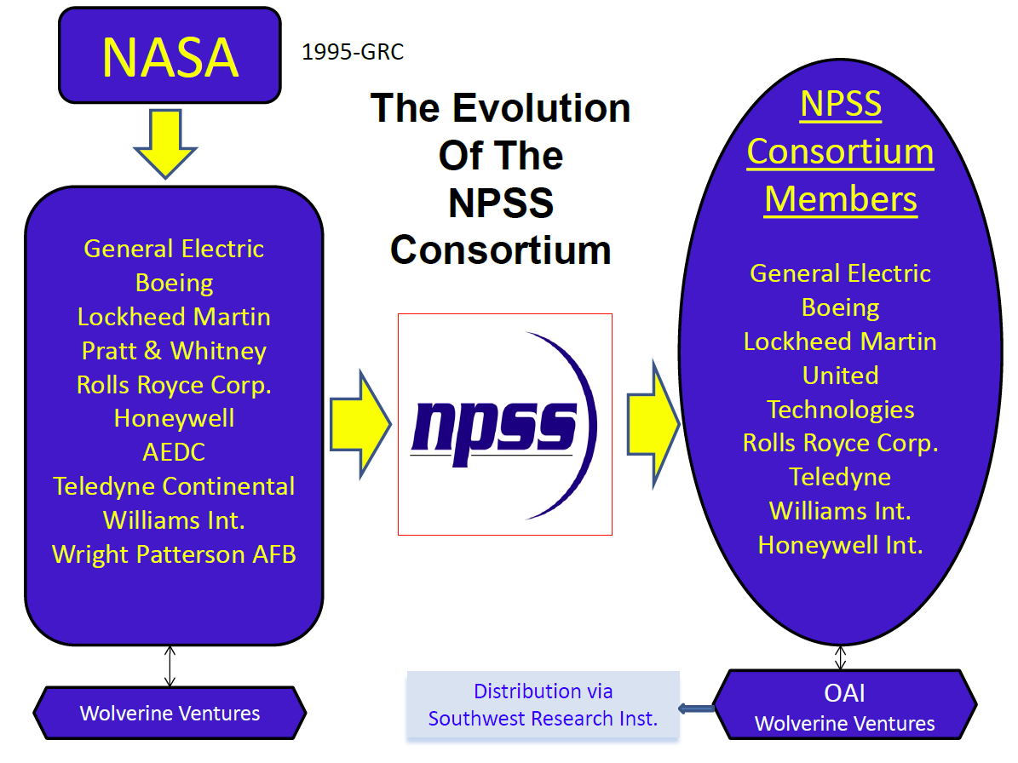
  NPSS Simulation Model
(NPSS Consortium)

Slide 19
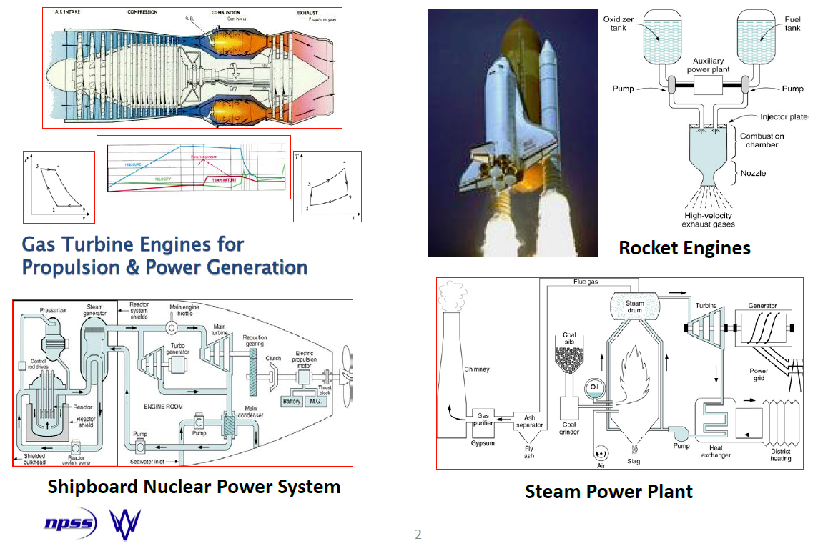
  NPSS Simulation Model
(NPSS Simulation Capabilities)

Slide 20
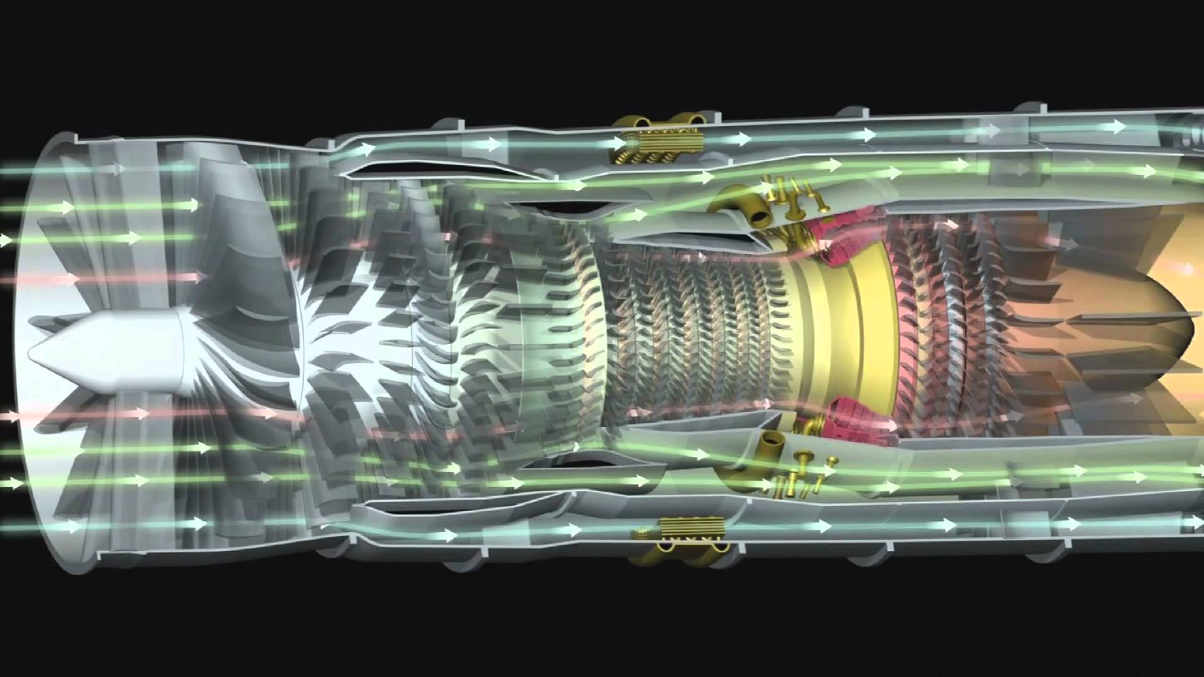
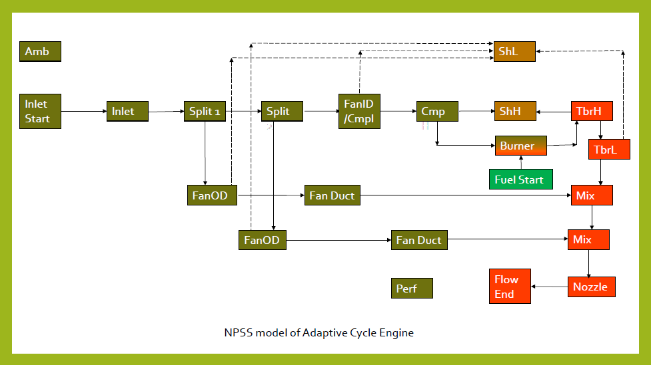
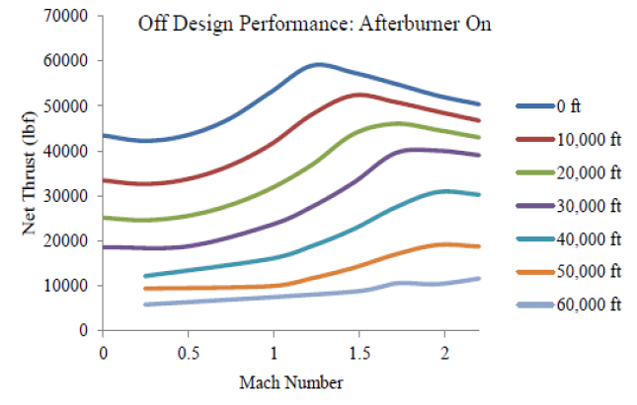
HiEff ModTM Power Generation System
(NPSS Simulation Capabilities)
GE – Adaptive Cycle Engine

Slide 21
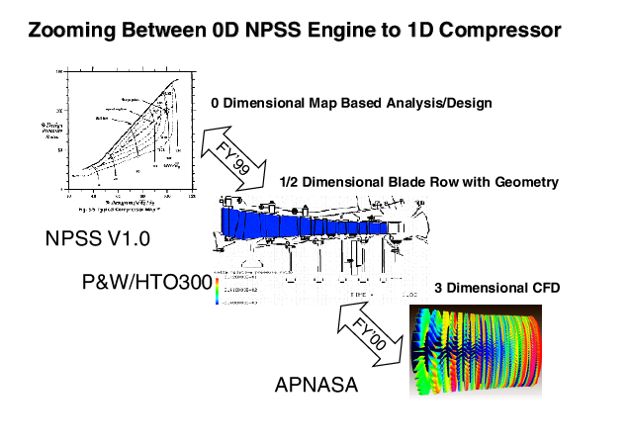
  NPSS Simulation Model
(NPSS “Zooming” Feature)
Zooming from 0D Compressor Map to 3D CFD Compressor Model

Slide 22
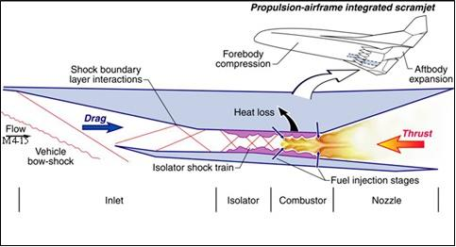
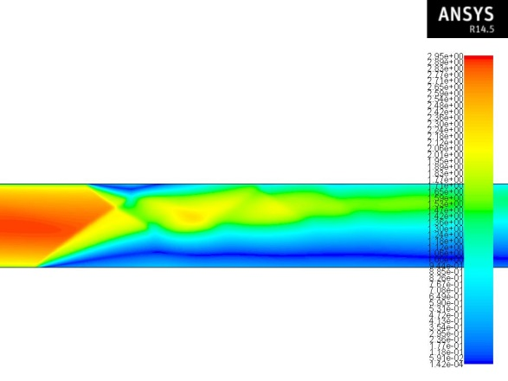
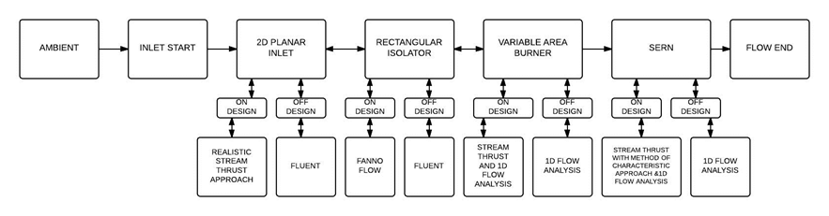
  NPSS Simulation Model
(NPSS “Zooming” Feature)
CFD simulation of inlet isolator (FLUENT)

Slide 23
HiEff ModTM Combined Cycle
Power Generation System
Outline
  Introduction - Simpkin HiEff ModTM Hi Efficiency Utility Rescue Concept
  NPSS Simulation Model
  HiEff/Rankine Combined Cycle
    Cycle Design & Performance Analysis
    Helium Compressor Model
    Indirect Helium/Argon Cycle
    Experimental Validation
  HiEff/sCO₂ Combined Cycle
    Cycle Design & Performance Analysis
    Experimental Validation
  HiEff/SC-FGR Cycle
  Path to Commercialization
  Appendix - NPSS Code

Slide 24
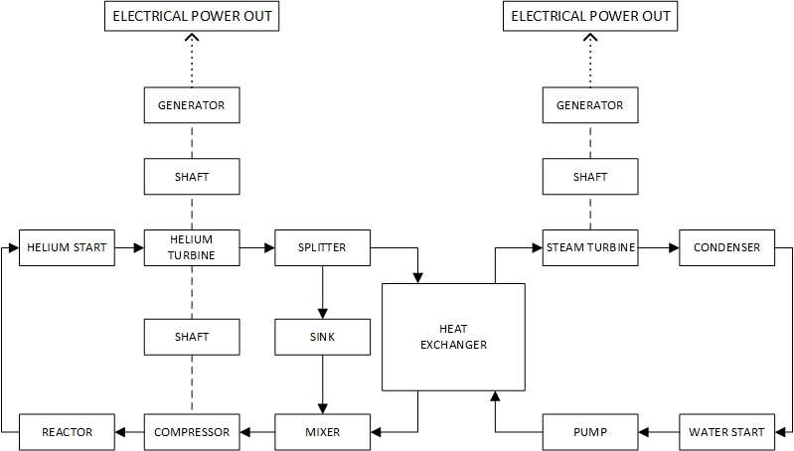
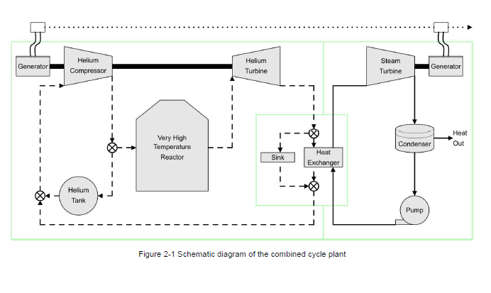
  HiEff/Rankine Combined Cycle
(NPSS Simulation)

Slide 25
  HiEff/Rankine Combined Cycle
(Design & Performance Analysis)
Reactor outlet temperature

Slide 26
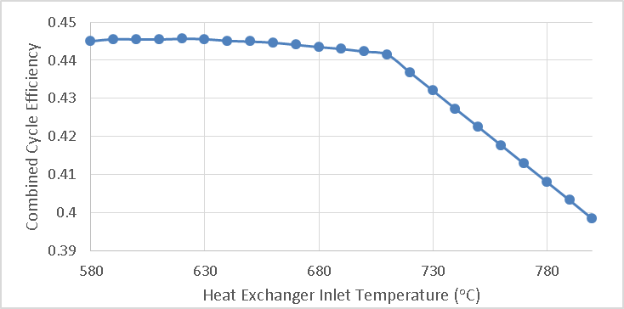
  HiEff/Rankine Combined Cycle
(Design & Performance Analysis)
Heat exchanger inlet (turbine exhaust) temperature

Slide 27
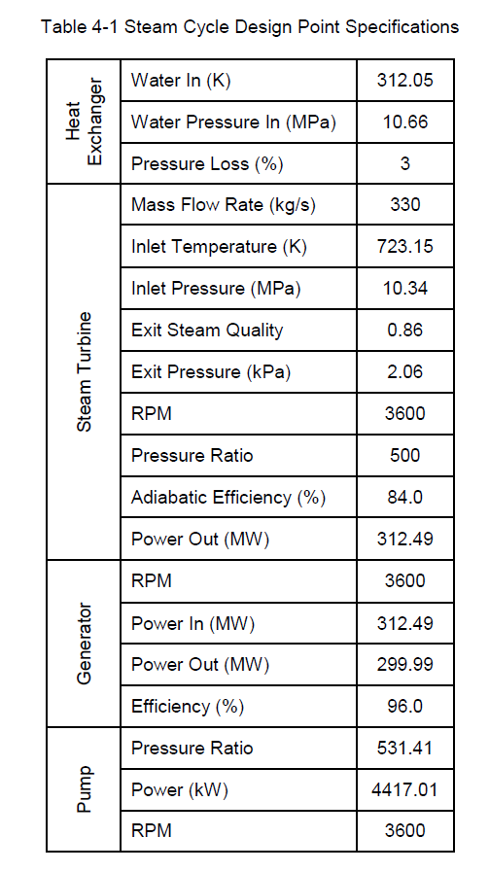
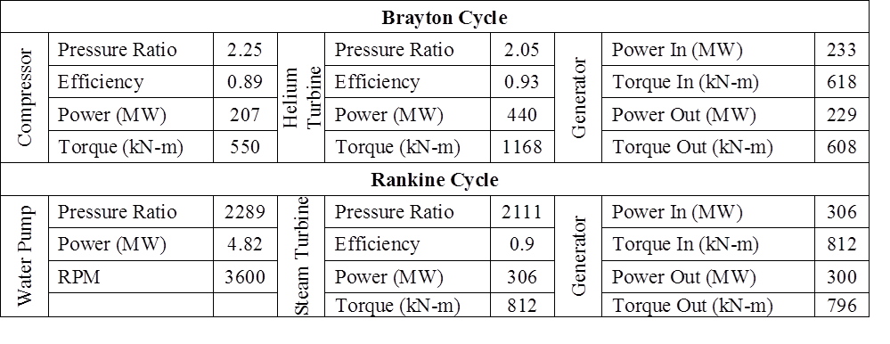
  HiEff/Rankine Combined Cycle
(Design Point Performance)
Reactor: Helium-cooled VHTR
    900 C/6.89 MPa/1188 MW_{t}
Heat exchanger pinch temperature = 14 K
Steam turbine: 300 MW_{e}
Rankine cycle efficiency = 37%
Gas turbine: 229 MW_{e}
Brayton cycle efficiency = 19%
Combined cycle efficiency = 45%

Slide 28
  HiEff/Rankine Combined Cycle
(Part Load Performance)
Reactor outlet temp = 900 C (Constant)

Slide 29
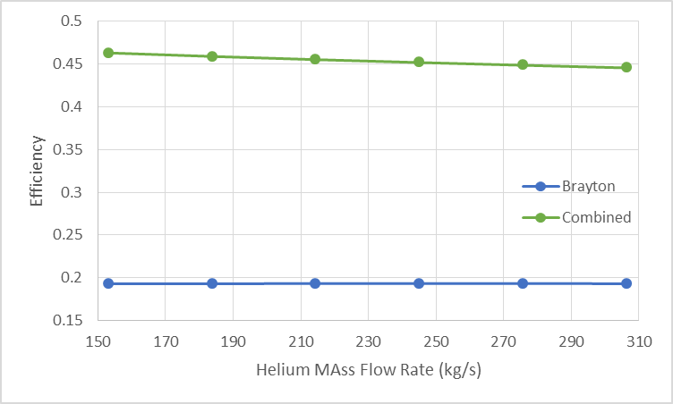
  HiEff/Rankine Combined Cycle
(Part Load Performance)
Reactor outlet temp = 900 C (Constant)

Slide 30
HiEff ModTM Combined Cycle
Power Generation System
Outline
  Introduction - Simpkin HiEff ModTM Hi Efficiency Utility Rescue Concept
  NPSS Simulation Model
  HiEff/Rankine Combined Cycle
    Cycle Design & Performance Analysis
    Helium Compressor Model
    Indirect Helium/Argon Cycle
    Experimental Validation
  HiEff/sCO₂ Combined Cycle
    Cycle Design & Performance Analysis
    Experimental Validation
  HiEff/SC-FGR Cycle
  Path to Commercialization
  Appendix - NPSS Code

Slide 31
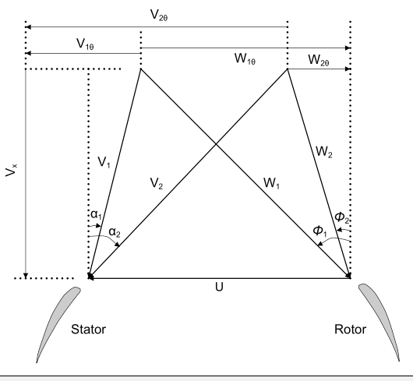
  HiEff/Rankine Combined Cycle
(Helium Compressor Model)
2-D Blade Element Model with semi-empirical corrections* for
Design angle of attack
Design incidence angle
Design deviation angle
Profile loss coefficient
Leakage loss coefficient
Incidence angle correction factor
*SAND2007-6218
Figure 2. Combined velocity triangle

Slide 32
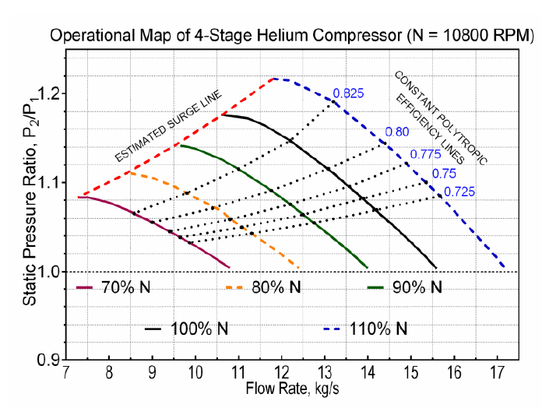
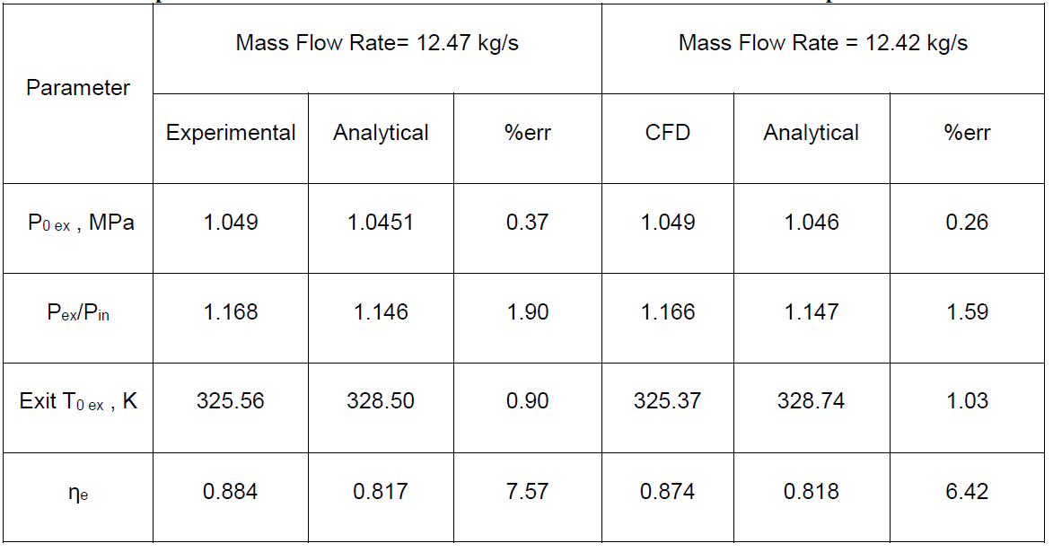
  HiEff/Rankine Combined Cycle
(Helium Compressor Model)
Model validation - JAEA 4-Stage Prototype He Compressor

Slide 33
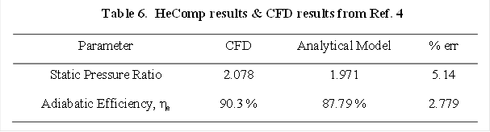
  HiEff/Rankine Combined Cycle
(Helium Compressor Model)
Model validation - JAEA 20-Stage He Compressor

Slide 34
HiEff ModTM Combined Cycle
Power Generation System
Outline
  Introduction - Simpkin HiEff ModTM Hi Efficiency Utility Rescue Concept
  NPSS Simulation Model
  HiEff/Rankine Combined Cycle
    Cycle Design & Performance Analysis
    Helium Compressor Model
    Indirect Helium/Argon Cycle
    Experimental Validation
  HiEff/sCO₂ Combined Cycle
    Cycle Design & Performance Analysis
    Experimental Validation
  HiEff/SC-FGR Cycle
  Path to Commercialization
  Appendix - NPSS Code

Slide 35
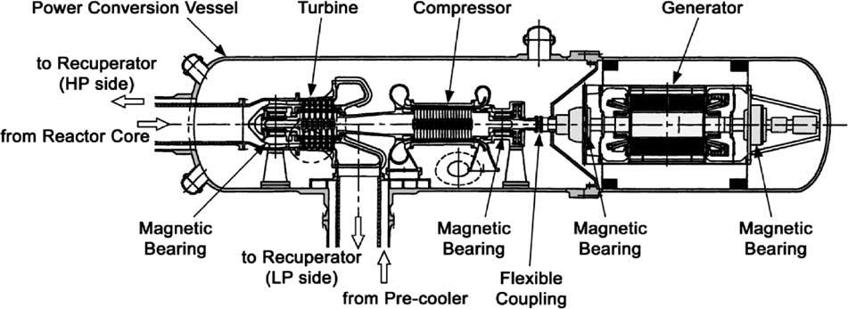
  HiEff/Rankine Combined Cycle
(Indirect Helium/Argon Cycle)
Longitudinal Cross-Section of the JAEA GTHTR300 Turbomachine[11]
Helium compressor; 20 stages, pressure ratio = 2.0, polytropic efficiency = 0.905
Helium turbine; 6 stages, pressure ratio = 1.87, polytropic efficiency = 0.93

Slide 36
  HiEff/Rankine Combined Cycle
(Indirect Helium/Argon Cycle)

Slide 37
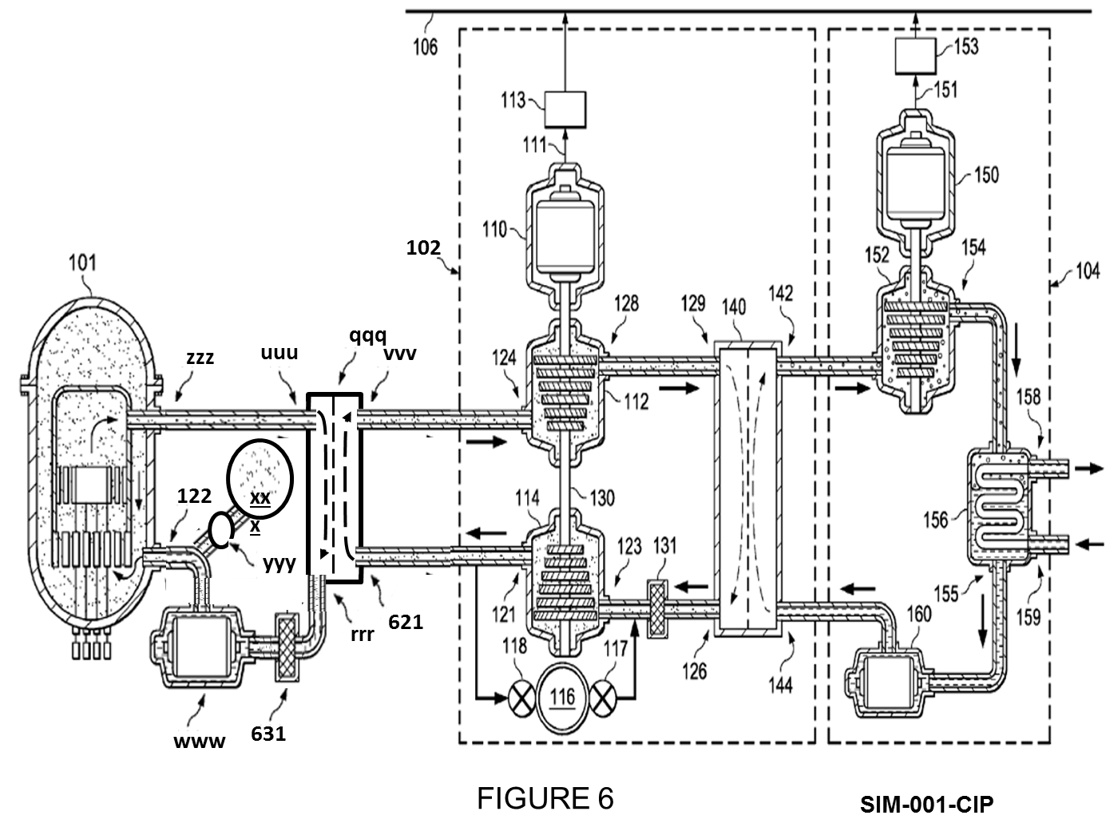
  HiEff/Rankine Combined Cycle
(Indirect Helium/Argon Cycle)

Slide 38
  HiEff/Rankine Combined Cycle
(Indirect Helium/Argon Cycle)
Result: He/Ar (50/50) Indirect Cycle
10% reduction in power
6% reduction in overall efficiency
44% reduction in number of compressor stages
13.5% efficiency & 59% power increase over Rankine cycle for a 41% increase in thermal power input

Slide 39
HiEff ModTM Combined Cycle
Power Generation System
Outline
  Introduction - Simpkin HiEff ModTM Hi Efficiency Utility Rescue Concept
  NPSS Simulation Model
  HiEff/Rankine Combined Cycle
    Cycle Design & Performance Analysis
    Helium Compressor Model
    Indirect Helium/Argon Cycle
    Experimental Validation
  HiEff/sCO₂ Combined Cycle
    Cycle Design & Performance Analysis
    Experimental Validation
  HiEff/SC-FGR Cycle
  Path to Commercialization
  Appendix - NPSS Code

Slide 40
  HiEff/Rankine Combined Cycle
(Concept Validation Options)
Build small-scale prototype facility to test concept feasibility and validate NPSS simulation model
  ARC DC power supply Reactor simulation
  Turbine Technology Gas turbine components
  ARC Helium tank, Rankine cycle simulation, heat exchangers, DAS/Control system
Modify Tsinghua HTR-10GT facility
  Operational helium-cooled VHTR/gas turbine prototype facility
  10 MW_{t} reactor/He gas turbine/2.5 MW_{e} generator
  Permission ?, Feasibility ?, Cost ?/Funding support ?

Slide 41
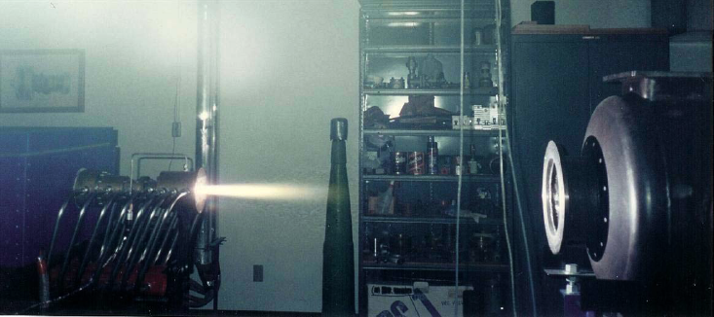
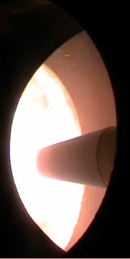
  HiEff/Rankine Combined Cycle
(Small-scale Prototype Option)
ARC Arcjet facility
1.6 MW DC power supply ⇒ Reactor simulation
800 kW cooling water system ⇒Rankine cycle
  1.6 MW (2000v, 800 amp) DC power supply
  350 psi, 400 gpm deionized cooling water system
  Total enthalpy, h_{t} ∼ 4000 to 6000 kJ/kg
  Arc heater donation from AEDC (USAF)

Slide 42
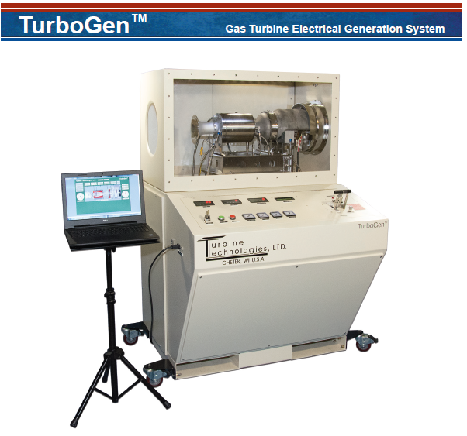
  HiEff/Rankine Combined Cycle
(Small-scale Prototype Option)
Turbine Technologies ⇒ Brayton Cycle
TurboGen Gas Turbine
Power Generation System
Gas turbine;
  Thrust = 178 N(40 lbf)
  Flow rate = 0.5 kg/s
  RPM = 87,000
  CPR = 3.4
Generator;
  Voltage = 13.1V
  Current = 194A
  Power = 2.54 kW

Slide 43
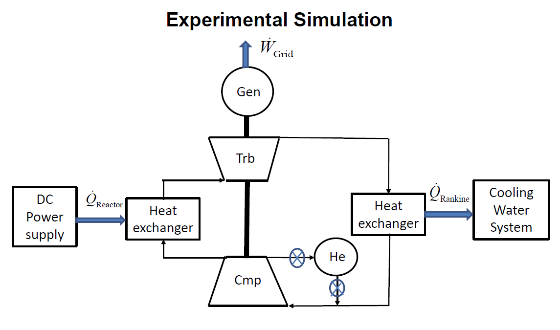
  HiEff/Rankine Combined Cycle
(Small-scale Prototype Option)

Slide 44
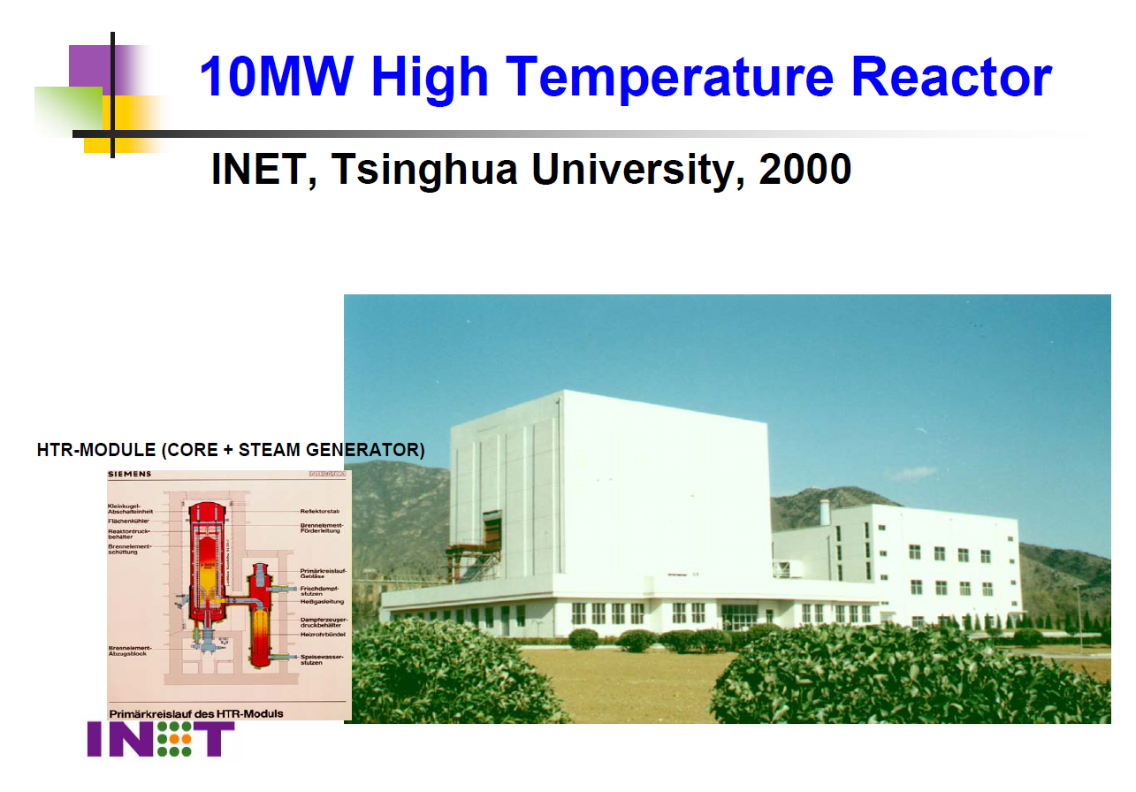

Slide 45
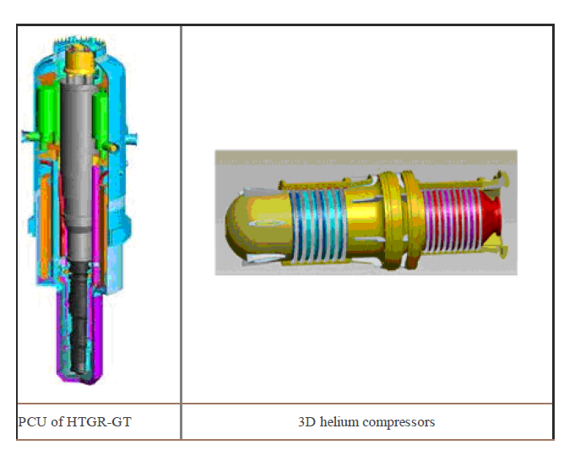
“The TSINGHUHTR-10GT will be the first test of a HTGR coupled with direct gas turbine
Generator in the world and will offer the key technologies for the advanced development
of commercial demonstrated HTGR-GT power plants”

Slide 46
HTR-10 Main Milestones
[Fu Li, “HTR Progress in China,” April 2014]
March 14, 1992: Project approval by Government
Dec 1992-Dec 1994: PSAR
Dec 15, 1998-Nov.17, 2000: FSAR
July 16, 1995-Dec. 2000: Construction
Dec.1, 2000: Physical critical
Jan 7, 2003: Electricity output to grid
Jan 29, 2003: Full power operation
Oct.15, 2003: safety demonstration experiments and long-term operation
  CR withdrawal without Control Rod Drop, helium blower trip without Control Rod Drop, flap close failure without Control Rod Drop
  Many experiments followed, more will be planned

Slide 47
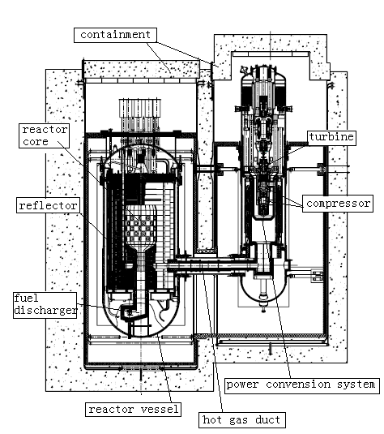
Physical Characteristics
Pebble bed
Helium cooled, graphite moderated
Modular High-Temperature Gas-Cooled reactor
  750 C Exit Temperature
  Inherent safety
  Free from melt-down
Performance
Reactor: 10 MW_{th}
Generator: 2.5 Mw_{e}
Efficiency: 25%

Slide 48
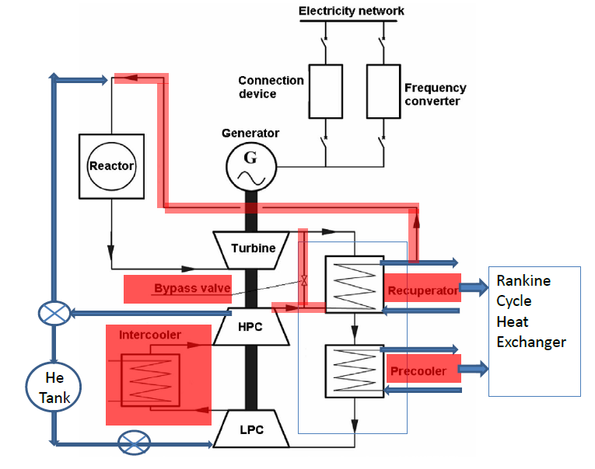
Modified HTR-10GT Flow Chart

Slide 49
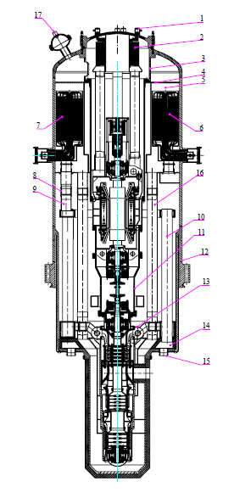
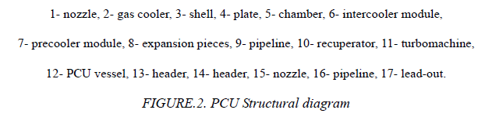
Tsinghua HTR-10GT Option
Critical issues
Obtaining permission to modify facility
Technical feasibility of modifying PCU
Cost
Funding source

Slide 50
  HiEff/Rankine Combined Cycle
(INL Program – Status Report)
INL Visit (July 28) – followed by a draft white paper submitted to Mike McKellar for distribution to potential funding sources
    Laboratory Directed Research and Development (LDRD)
    Nuclear Energy University Program (NEUP)
    National University Consortium (NUC)
Proposed steps
  NPSS Code upgrades
      Update compressor & turbine routines
      Reactor simulation - INL Moose computer code
      Heat exchanger – Sandia model
    Design optimization (direct & indirect cycles)
    Part-load performance
    Simulation of transient scenarios
    Experimental validation
      Small-scale experimental program
      Tsinghua experimental program ?
  NPSS code refinement/Large-scale performance predictions

Slide 51
HiEff ModTM Combined Cycle
Power Generation System
Outline
  Introduction - Simpkin HiEff ModTM Hi Efficiency Utility Rescue Concept
  NPSS Simulation Model
  HiEff/Rankine Combined Cycle
    Cycle Design & Performance Analysis
    Helium Compressor Model
    Indirect Helium/Argon Cycle
    Experimental Validation
  HiEff/sCO₂ Combined Cycle
    Numerical Simulation
    Experimental Validation
  HiEff/SC-FGR Cycle
  Path to Commercialization
  Appendix - NPSS Code

Slide 52
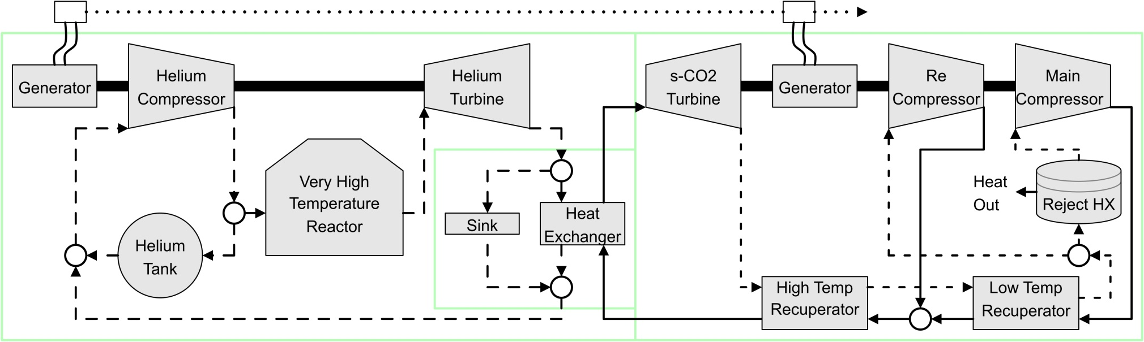
HiEff /sCO₂ Combined Cycle
(Cycle Schematic)
Sandia National Labs, August 15, 2016
Meeting with SNL sCO₂ Group; Gary Rochau, Sal Rodriguez, Blake Lance, Jim Pasch, and others
Demonstration of SNL CFD capabilities, Tour of sCO₂ test facilities, Seminar, Informal discussions on potential areas of collaboration
Schematic of the HiEff/sCO₂ combined cycle

Slide 53
HiEff /sCO₂ Combined Cycle
(Numerical Simulation)
NEUP Pre-Application Proposal (Sept. 14, 2016)
HiEff/sCO₂ Brayton Combined Cycle Power Generation System Modeling and Development
UTA: Don Wilson & Frank Lu, SNL: Sal Rodriguez
Task 1: NPSS Simulation Upgrades
Turbomachinery – replace maps with mean-line blade element models
Reactor - link SNL MELCOR code for reactor simulation into NPSS
sCO₂ – link SNL Fuego code for sCO₂ loop simulation
Task 2: Code Validation
NPSS – experimental data from Air Brayton Cycle test lop
MELCOR – experimental data from 1 MW sCO₂ Integral Loop
Fuego – experimental data from sCO₂ Tall Loop [7]
Task 3: Code upgrades and application to
Cycle design optimization & off design performance analysis
Scaling for SMR and full-scale power generation systems

Slide 54
HiEff ModTM Combined Cycle
Power Generation System
Outline
  Introduction - Simpkin HiEff ModTM Hi Efficiency Utility Rescue Concept
  NPSS Simulation Model
  HiEff/Rankine Combined Cycle
    Cycle Design & Performance Analysis
    Helium Compressor Model
    Indirect Helium/Argon Cycle
    Experimental Validation
  HiEff/sCO₂ Combined Cycle
    Cycle Design & Performance Analysis
    Experimental Validation
  HiEff/SC-FGR Cycle
  Path to Commercialization
  Appendix - NPSS Code

Slide 55
HiEff /sCO₂ Combined Cycle
(Experimental Validation)
NEUP Pre-Application Proposal (Sept. 14, 2016)
HiEff/sCO₂ Brayton Combined Cycle Proof of Concept
UTA: Don Wilson & Frank Lu, SNL: Blake Lance
Task 1: Experimental Proof-of-Concept Test Program
30 kW_{e} Capstone C-30 gas turbine generator was converted by SNL to a Closed Brayton Cycle (CBC) Loop (available test bed)
CBC 100 kW_{t} electric heater nuclear reactor heat source
CBC chiller heat rejection to sCO₂ loop
2200 psig gas storage bottles HiEff variable density helium tank
Task 2: Code Validation
NPSS simulation of Task 1 validation test used to guide code refinement
Task 3: Cycle Optimization
Upgraded NPSS code will be used to optimize cycle for maximum efficiency

Slide 56
HiEff /sCO₂ Combined Cycle
(Experimental Validation)
Sandia Air Brayton Cycle Test Facility

Slide 57
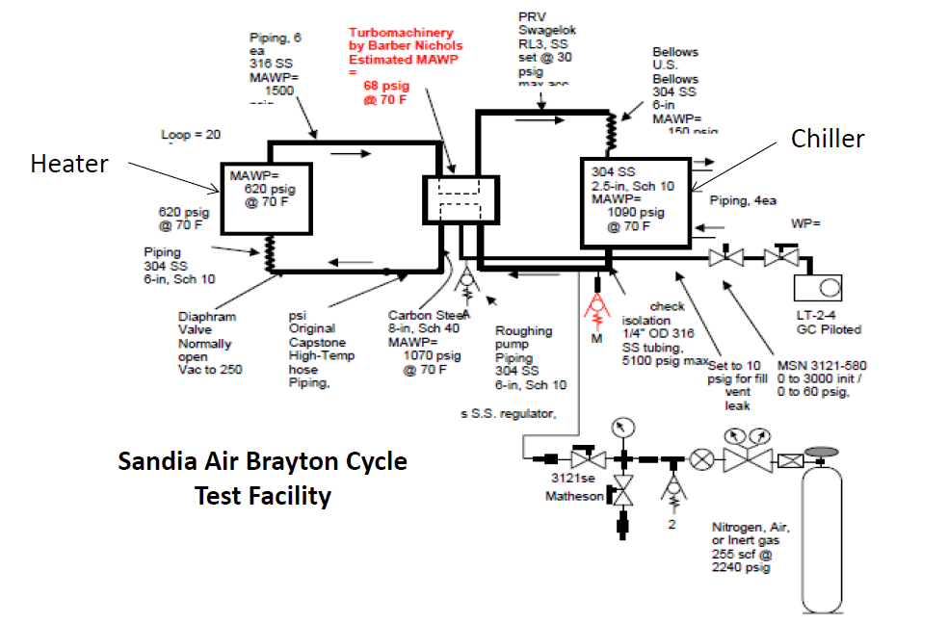
HiEff /sCO₂ Combined Cycle
(Experimental Validation)
He Tank Simulation

Slide 58
HiEff ModTM Combined Cycle
Power Generation System
Outline
  Introduction - Simpkin HiEff ModTM Hi Efficiency Utility Rescue Concept
  NPSS Simulation Model
  HiEff/Rankine Combined Cycle
    Cycle Design & Performance Analysis
    Helium Compressor Model
    Indirect Helium/Argon Cycle
    Experimental Validation
  HiEff/sCO₂ Combined Cycle
    Cycle Design & Performance Analysis
    Experimental Validation
  HiEff/SC-FGR Cycle
  Path to Commercialization
  Appendix - NPSS Code

Slide 59
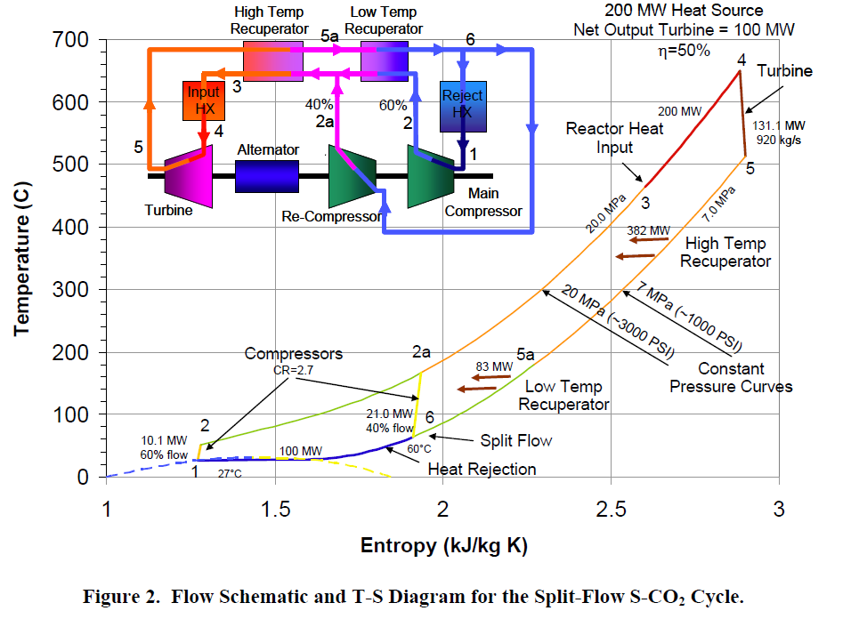
HiEff/ SC-FGR Cycle
(SC-FGR Cycle, SAND2011-2525)

Slide 60
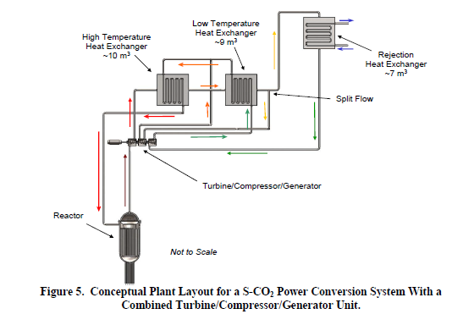
HiEff/ SC-FGR Cycle
(SC-FGR Cycle, SAND2011-2525)
CO₂
Conversion to combined Cycle by replacing recuperators with heat exchange to bottom cycle ??

Slide 61
HiEff ModTM Gas Turbine/VHTR/Steam Power Generation System
Outline
  Introduction - Simpkin HiEff ModTM Hi Efficiency Utility Rescue Concept
  NPSS Simulation Model
  HiEff/Rankine Combined Cycle
    Cycle Design & Performance Analysis
    Helium Compressor Model
    Indirect Helium/Argon Cycle
    Experimental Validation
  HiEff/sCO₂ Combined Cycle
    Cycle Design & Performance Analysis
    Experimental Validation
  HiEff/SC-FGR Cycle
  Path to Commercialization
  Appendix - NPSS Code

Slide 62
HiEff ModTM Power Generation System
(Path to Commercialization)
Technical issues
Direct (helium) vs indirect (helium, helium/argon mixtures) cycle
  Lower capital investment (indirect - fewer turbomachinery stages) vs. lower operational cost (direct - higher efficiency)
Further numerical studies
  Development of helium and helium/argon turbomachinery maps
  Reactor simulation (INL Moose, SNL MELCOR)
  sCO2 simulation (SNL Fuego)
  Additional cycle design optimization
  Part-load performance
  Transients; load following, start-up, emergency shutdown, ?
  Experimental validation (concept validation, code refinement)
  Small-scale prototype experiment
  SNL Air Brayton CBC test loop
  Tsinghua (proof of concept) ?
Path to commercialization
  ??

